Slide 1
Agent Harnesses & Deep Agents 101
Jess Weng

Slide 2


Your Speakers
Jess Weng
Ishaan Lal

Slide 3
Agenda
1.
INTRODUCTION TO DEEP AGENTS
2.
BUILD A DEEP AGENT
3.
Q & A

Slide 4
What is an agent?

Slide 5
A model calling tools in a loop until it completes a task
and returns a result.
input

Slide 6
A model calling tools in a loop until it completes a task
and returns a result.
input
model

Slide 7
A model calling tools in a loop until it completes a task
and returns a result.
input
model
tool

Slide 8
A model calling tools in a loop until it completes a task
and returns a result.
input
model
tool

Slide 9
A model calling tools in a loop until it completes a task
and returns a result.
input
model
tool

Slide 10
A model calling tools in a loop until it completes a task
and returns a result.
input
model
tool

Slide 11
A model calling tools in a loop until it completes a task
and returns a result.
input
model
tool

Slide 12
A model calling tools in a loop until it completes a task
and returns a result.
input
model
tool

Slide 13
A model calling tools in a loop until it completes a task
and returns a result.
input
model
tool
output

Slide 14
A model calling tools in a loop until it completes a task
and returns a result.
input
model
tool
output

Slide 15
A model calling tools in a loop until it completes a task
and returns a result.
input
model
tool
(part of the harness)
output

Slide 16
What is an agent?
Agent
=
Model
+
Harness

Slide 17

Skills
Tools
Memory
Context
System Prompt
Subagents
Agent = model + harness

Slide 18

Skills
Tools
Memory
Context
System Prompt
Subagents
Agent = model + harness
LLM

Slide 19
Skills
Tools
Memory
Context
System Prompt
Subagents
Agent = model + harness

Slide 20
Skills
Tools
Memory
Context
System Prompt
Subagents
Agent = model + harness

Slide 21

What makes a good harness?

Slide 22
Skills
Tools
Memory
Context
System Prompt
Subagents
What is the job of a harness?

Slide 23

Skills
Tools
Memory
Context
System Prompt
Subagents
What is the job of a harness?
To get
the model
the right context
at the right time
for the given
task.

Slide 24
Why do you need a harness?
Work in an environment where they can take actions
Connect to your data
Manage growing context over long runs
Parallelize tasks
Connect with a human in the loop
Improve over time

Slide 25
What is Deep Agents?
Agent
=
Model
+
Harness

Slide 26
What is Deep Agents?
Agent
=
Model
+
DA Harness
Harness

Slide 27
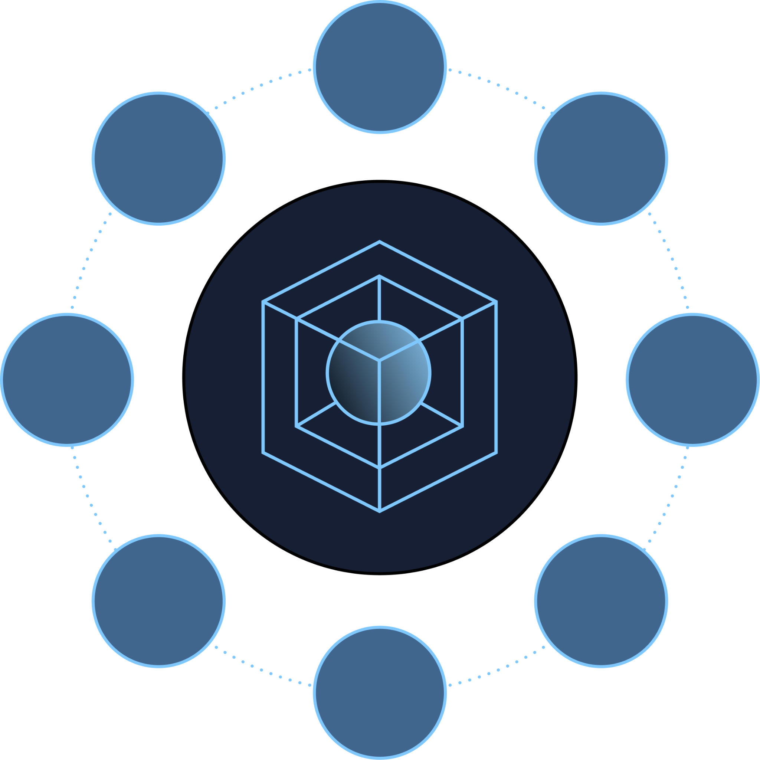
What is Deep Agents?
A customizable agent harness purpose built for complex, real-world tasks.

Slide 28
Why Deep Agents?
01
02
03
Provider agnostic
Highly customizable
Production ready

Slide 29
Why Deep Agents?
01
02
03
Provider agnostic
Highly customizable
Production ready

Slide 30
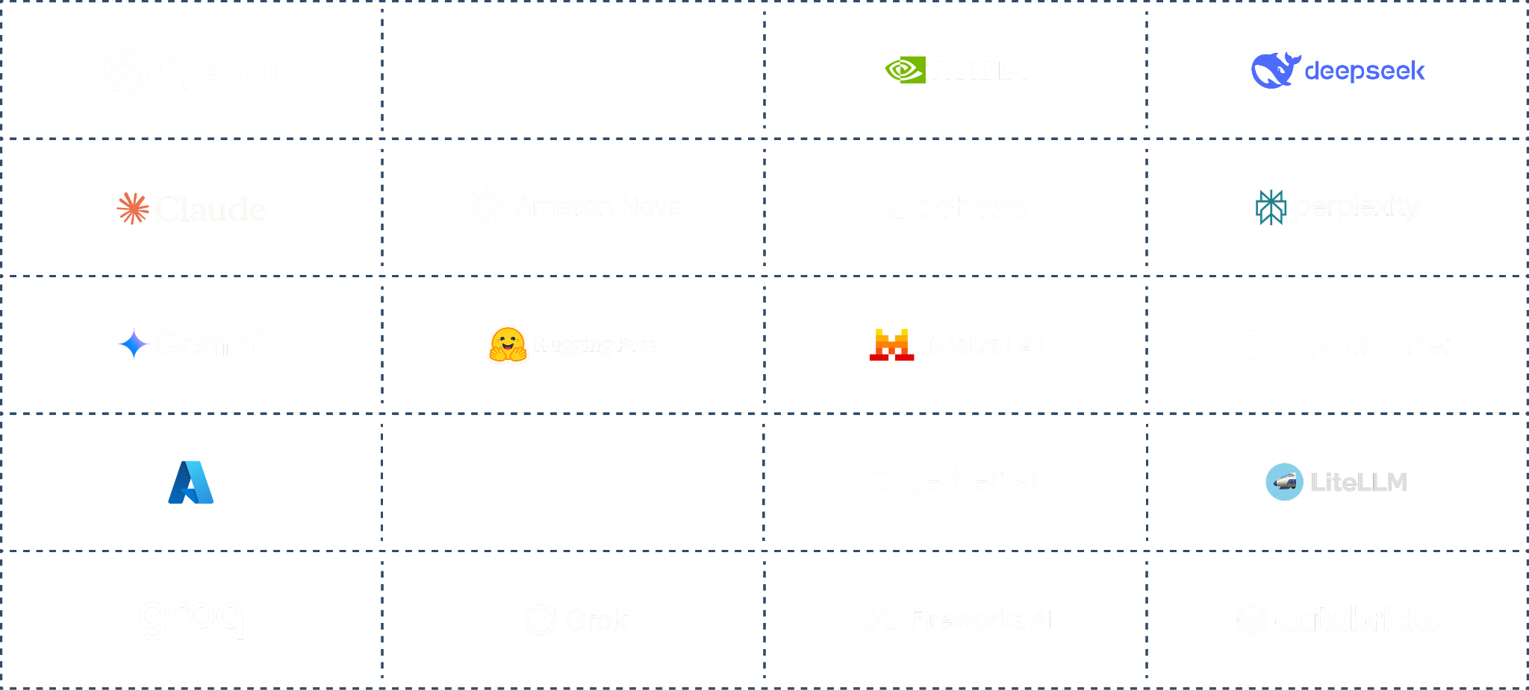
Provider agnostic

Slide 31
Why Deep Agents?
01
02
03
Provider agnostic
Highly customizable
Production ready

Slide 32
Base Deep Agents harness
Execution Environment
Code Interpreter
Sandbox
Filesystem
Anatomy of a harness

Slide 33
Base Deep Agents harness
Execution Environment
Code Interpreter
Sandbox
Filesystem
Skills
Memory
Summarization
Context offloading
Prompt caching
Context management
Anatomy of a harness

Slide 34
Base Deep Agents harness
Execution Environment
Delegation
Code Interpreter
Sandbox
Filesystem
Planning
Subagents
Skills
Memory
Summarization
Context offloading
Prompt caching
Context management
Anatomy of a harness

Slide 35
Base Deep Agents harness
Execution Environment
Delegation
Middleware
Code Interpreter
Sandbox
Filesystem
Planning
Subagents
Human-in-the-loop
Skills
Memory
Summarization
Context offloading
Prompt caching
Context management
Anatomy of a harness

Slide 36
Base Deep Agents harness
Execution Environment
Delegation
Middleware
Code Interpreter
Sandbox
Filesystem
Planning
Subagents
Human-in-the-loop
Skills
Memory
Summarization
Context offloading
Prompt caching
Context management
Anatomy of a harness

Slide 37
HITL
input

Slide 38
HITL
input
model

Slide 39

HITL
input
model
tool

Slide 40
HITL
input
model
delete_file

Slide 41

HITL
input
model
delete_file

Slide 42

HITL
input
model
delete_file

Slide 43
HITL
input
model
delete_file

Slide 44
HITL
input
model
delete_file

Slide 45

HITL
input
model
delete_file
output

Slide 46
HITL
input
model
delete_file
output

Slide 47
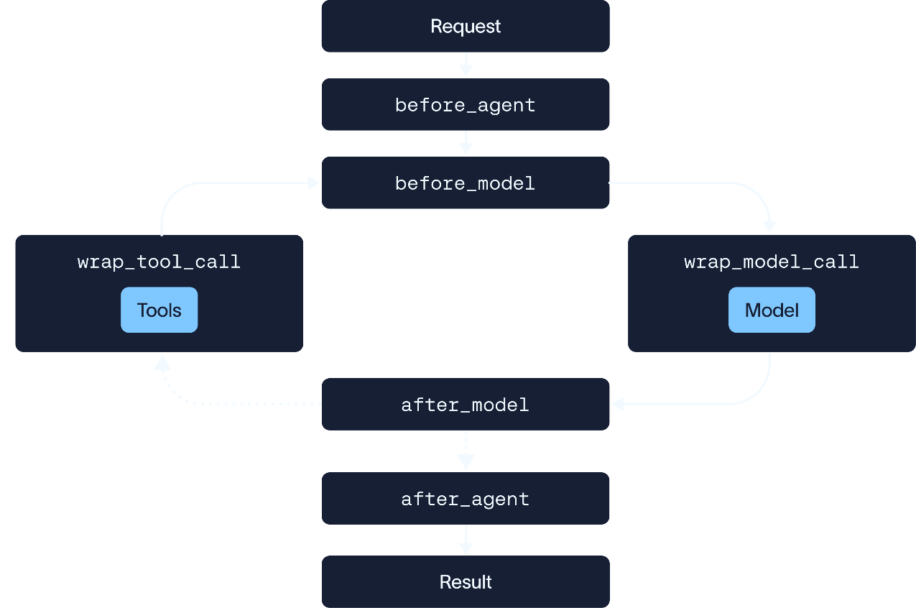
Middleware:
Hooks that allow you to customize behavior in the agent loop

Slide 48
Middleware:
Hooks that allow you to customize behavior in the agent loop

Slide 49
Middleware:
Hooks that allow you to customize behavior in the agent loop

Slide 50
Middleware:
Hooks that allow you to customize behavior in the agent loop

Slide 51
Middleware:
Hooks that allow you to customize behavior in the agent loop

Slide 52
Middleware:
Hooks that allow you to customize behavior in the agent loop
Human-In-The-Loop

Slide 53
HITL
input
=
model
tool
output

Slide 54
Base Deep Agents harness
Execution Environment
Delegation
Middleware
Code Interpreter
Sandbox
Filesystem
Planning
Subagents
Human-in-the-loop
Skills
Memory
Summarization
Context offloading
Prompt caching
Context management
Anatomy of a harness

Slide 55
Base Deep Agents harness
Execution Environment
Delegation
Middleware
Code Interpreter
Sandbox
Filesystem
Planning
Subagents
Human-in-the-loop
Skills
Memory
Summarization
Context offloading
Prompt caching
Context management
Anatomy of a harness

Slide 56
Subagents
input

Slide 57
Subagents
input
model

Slide 58
Subagents
input
model
context window

Slide 59
Subagents
input
model
context window
subagent
subagent

Slide 60
Subagents
input
model
context window
separate context window
subagent
subagent

Slide 61
Subagents
input
model
context window
separate context window
separate tools
subagent
subagent

Slide 62
Subagents
input
model
subagent
subagent

Slide 63
Subagents
input
model
subagent
subagent

Slide 64
Subagents
input
model
Scrape web for articles
Subagent A
Subagent B
Scrape video information

Slide 65
Subagents
input
model
Subagent A
Subagent B
tool
tool

Slide 66
Subagents
input
model
Subagent A
Subagent B
tool
tool

Slide 67
Subagents
input
model
Subagent A
Subagent B
tool
tool

Slide 68
Subagents
input
model
Subagent A
Subagent B
tool
tool

Slide 69
Subagents
input
model
Subagent A
Subagent B
tool
tool

Slide 70
Subagents
input
model
Subagent A
Subagent B
tool
tool
output

Slide 71

Model
Subagent

Slide 72

Model
Subagent

Slide 73
Why Deep Agents?
01
02
03
Provider agnostic
Highly customizable
Production ready

Slide 74
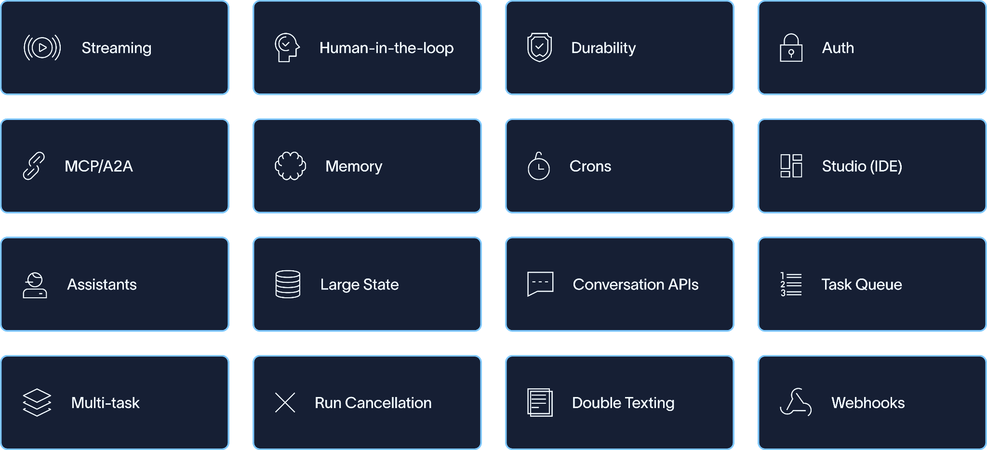
Challenges with deploying an agent:

Slide 75
Managed Deep Agents
Introducing

Slide 76
Build -> Test -> Deploy -> Monitor
An entire runtime environment
Deployments
New, related products
Sandboxes
langchain / langgraph / deep agents
Code Execution
LLM Gateway
Model
Tools
Tool Server*
Context
* in development
Context Hub

Slide 77
Build -> Test -> Deploy -> Monitor
Managed Deep Agents
Deployments
New, related products
Sandboxes
langchain / langgraph / deep agents
Code Execution
LLM Gateway
Model
Tools
Tool Server*
Context
* in development
Context Hub

Slide 78
Desired Agent Behavior
What the DA Harness Adds
Work with real data durably
Virtual filesystem support

Slide 79
Desired Agent Behavior
What the DA Harness Adds
Work with real data durably
Virtual filesystem support
Write and execute code
Code execution via execute tool
and sandboxes

Slide 80
Desired Agent Behavior
What the DA Harness Adds
Work with real data durably
Virtual filesystem support
Write and execute code
Code execution via execute tool
and sandboxes
Safe execution
Sandboxes, filesystem permissions
and middleware hooks

Slide 81
Desired Agent Behavior
What the DA Harness Adds
Work with real data durably
Virtual filesystem support
Write and execute code
Code execution via execute tool
and sandboxes
Safe execution
Sandboxes, filesystem permissions
and middleware hooks
Access and remember knowledge
Memory, skills, MCP

Slide 82
Desired Agent Behavior
What the DA Harness Adds
Work with real data durably
Virtual filesystem support
Write and execute code
Code execution via execute tool
and sandboxes
Safe execution
Sandboxes, filesystem permissions
and middleware hooks
Access and remember knowledge
Memory, skills, MCP
Complete long horizon work
Built-in context management

Slide 83
Desired Agent Behavior
What the DA Harness Adds
Work with real data durably
Virtual filesystem support
Write and execute code
Code execution via execute tool
and sandboxes
Safe execution
Sandboxes, filesystem permissions
and middleware hooks
Access and remember knowledge
Memory, skills, MCP
Complete long horizon work
Built-in context management
Optimized for provider and model choice
Harness profiles

Slide 84

Demo
Building a Journal Deep Agent:
1. The Harness
2. The System Prompt
3. Adding Custom Tools
4. Human-In-The-Loop
5. Subagents
Colab Notebook
Link: https://colab.research.google.com/drive/18HnyRT_AualxB_YLK2sfN-2rwSyk4exx#scrollTo=6ab1c5c9

Slide 85

Take-Home Practice
Building your own Deep Agent:
Make a copy of today’s colab notebook
Add your api key to “secrets” and initialise your model
Create an agent by updating your system prompt and choosing tools
Optionally add memory and HITL
Wrap-up
Colab Notebook
Link: https://colab.research.google.com/drive/1PsgwiukuBY8h1QuMCqvTg-q-emoSv9zk#scrollTo=7869b798

Slide 86

To learn more:
Head over to LangChain Academy!
Any questions?
Reach out to jess.weng@langchain.dev
Link: https://academy.langchain.com/courses/foundation-introduction-to-deepagents

Slide 87

Managed Deep Agents Session (Oct 7)
Register here for Ishaan’s workshop!
Any questions?
Reach out to ishaan.lal@langchain.dev

